Slide 1
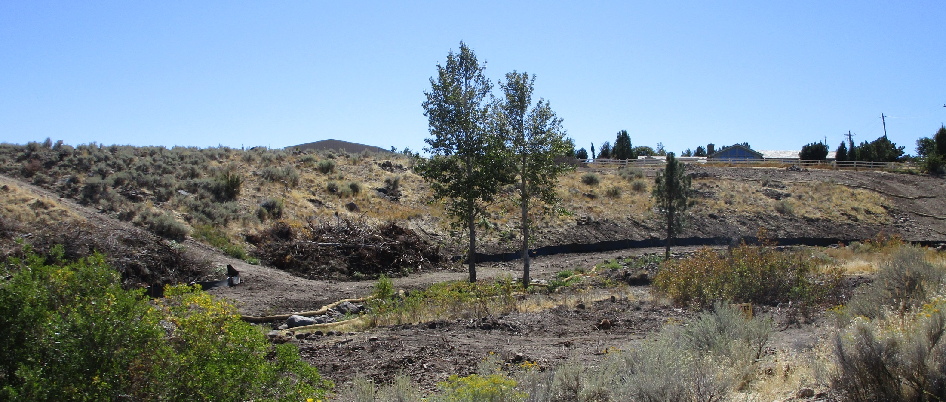
UPDATE
WSUP18-0017 Soule Grading
Washoe County Board of Adjustment
February 6,2020

Slide 2
Request
On October 4, 2018 the Board of Adjustment (BOA) approved WSUP18-0017 with conditions
One of the conditions required staff to report back to the BOA on the status of the conditions

Slide 3
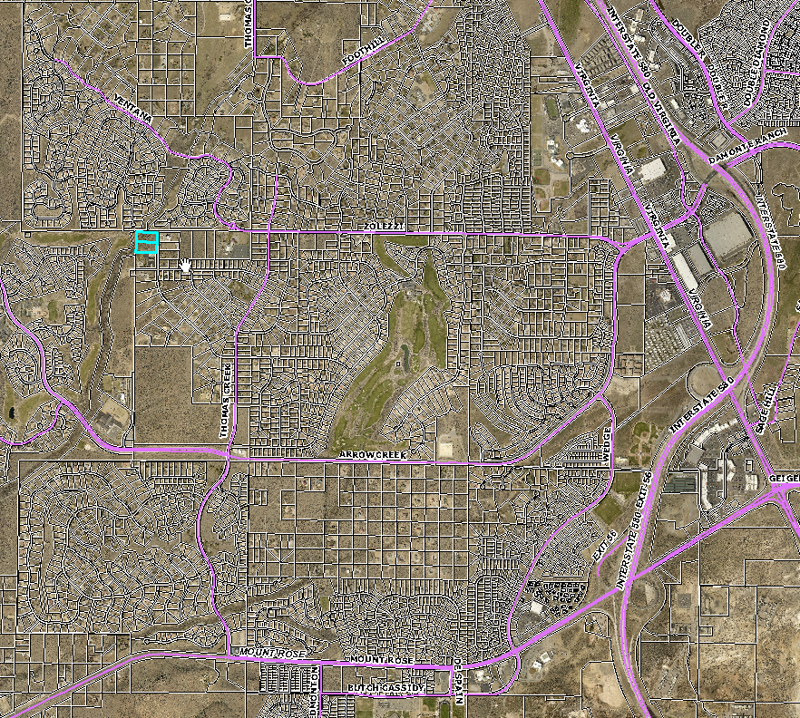
Project Site

Slide 4
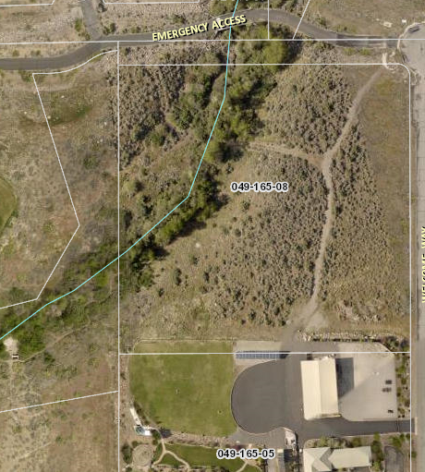

Slide 5
Background
In August Code Enforcement received complaints that grading was occurring along the west side of the Thomas Creek
Code Enforcement visit the site and a violation notice and a Stop Work Order were issued
On July 30, 2018 the property owner applied for a SUP
On October 4, 2018 the BOA approved a SUP with conditions

Slide 6
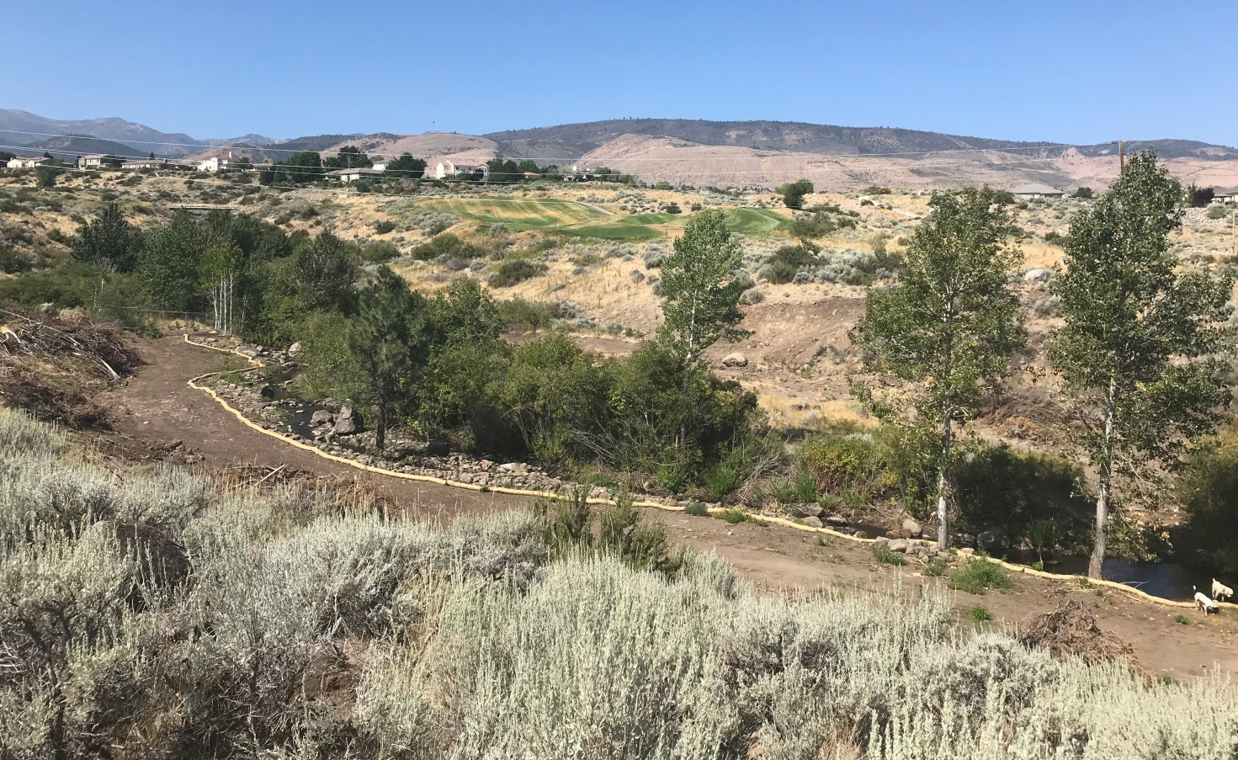
Photo of site on August 24th

Slide 7
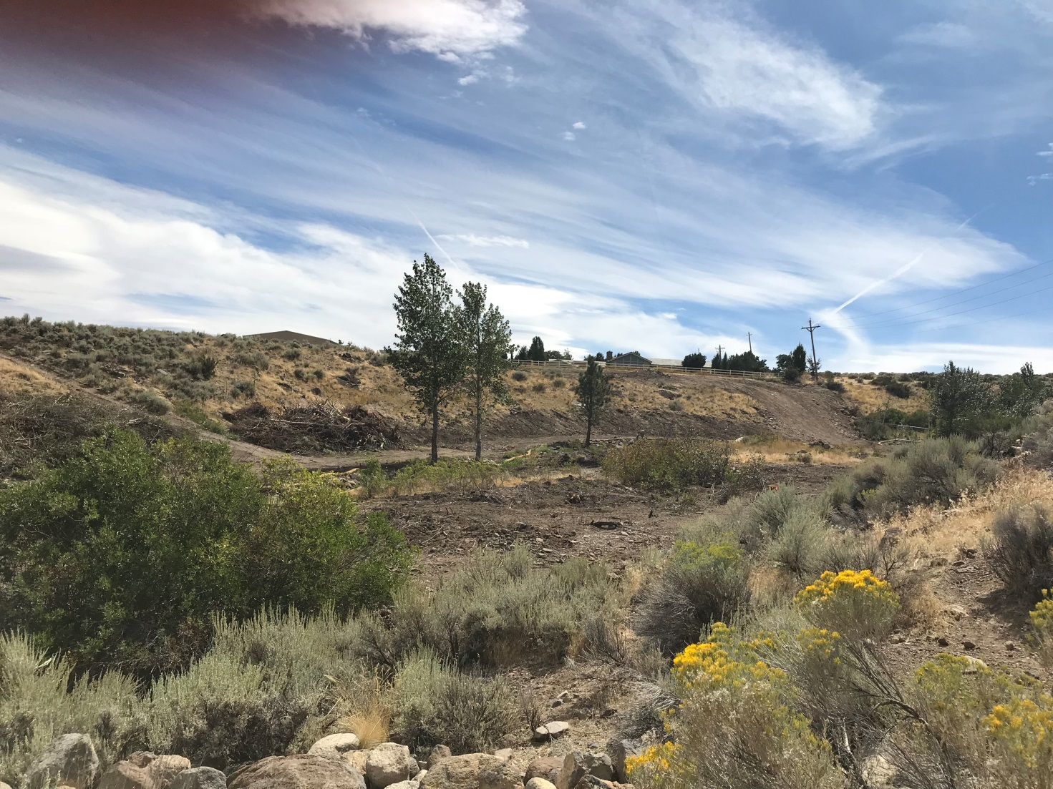
Photo of site on September 12, 2018

Slide 8
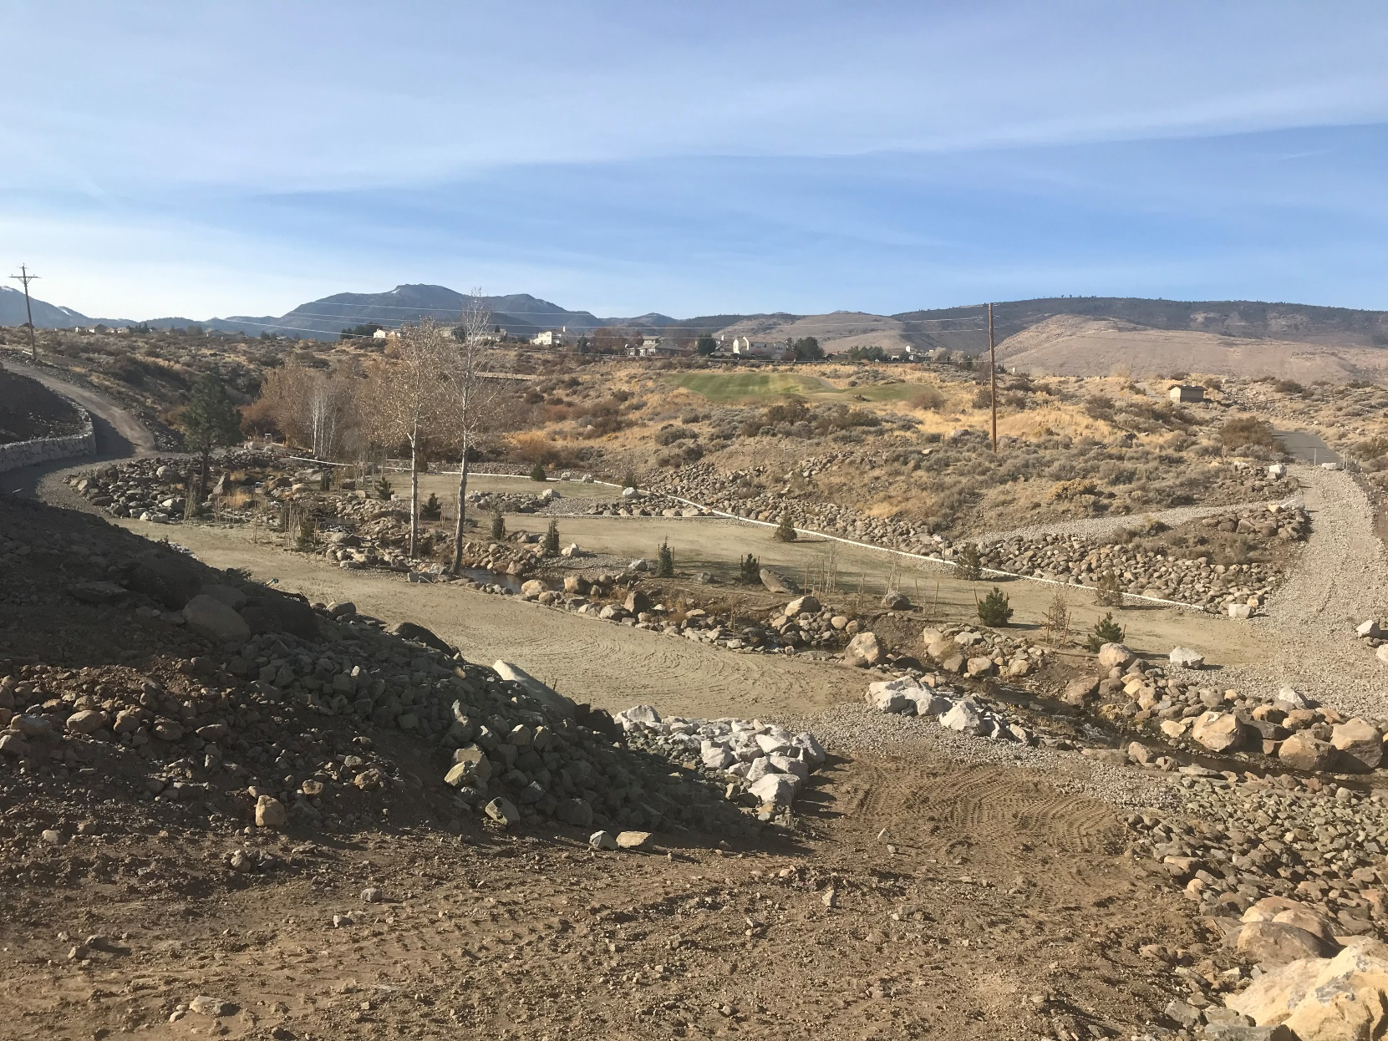
Photo of site on November 13, 2019

Slide 9
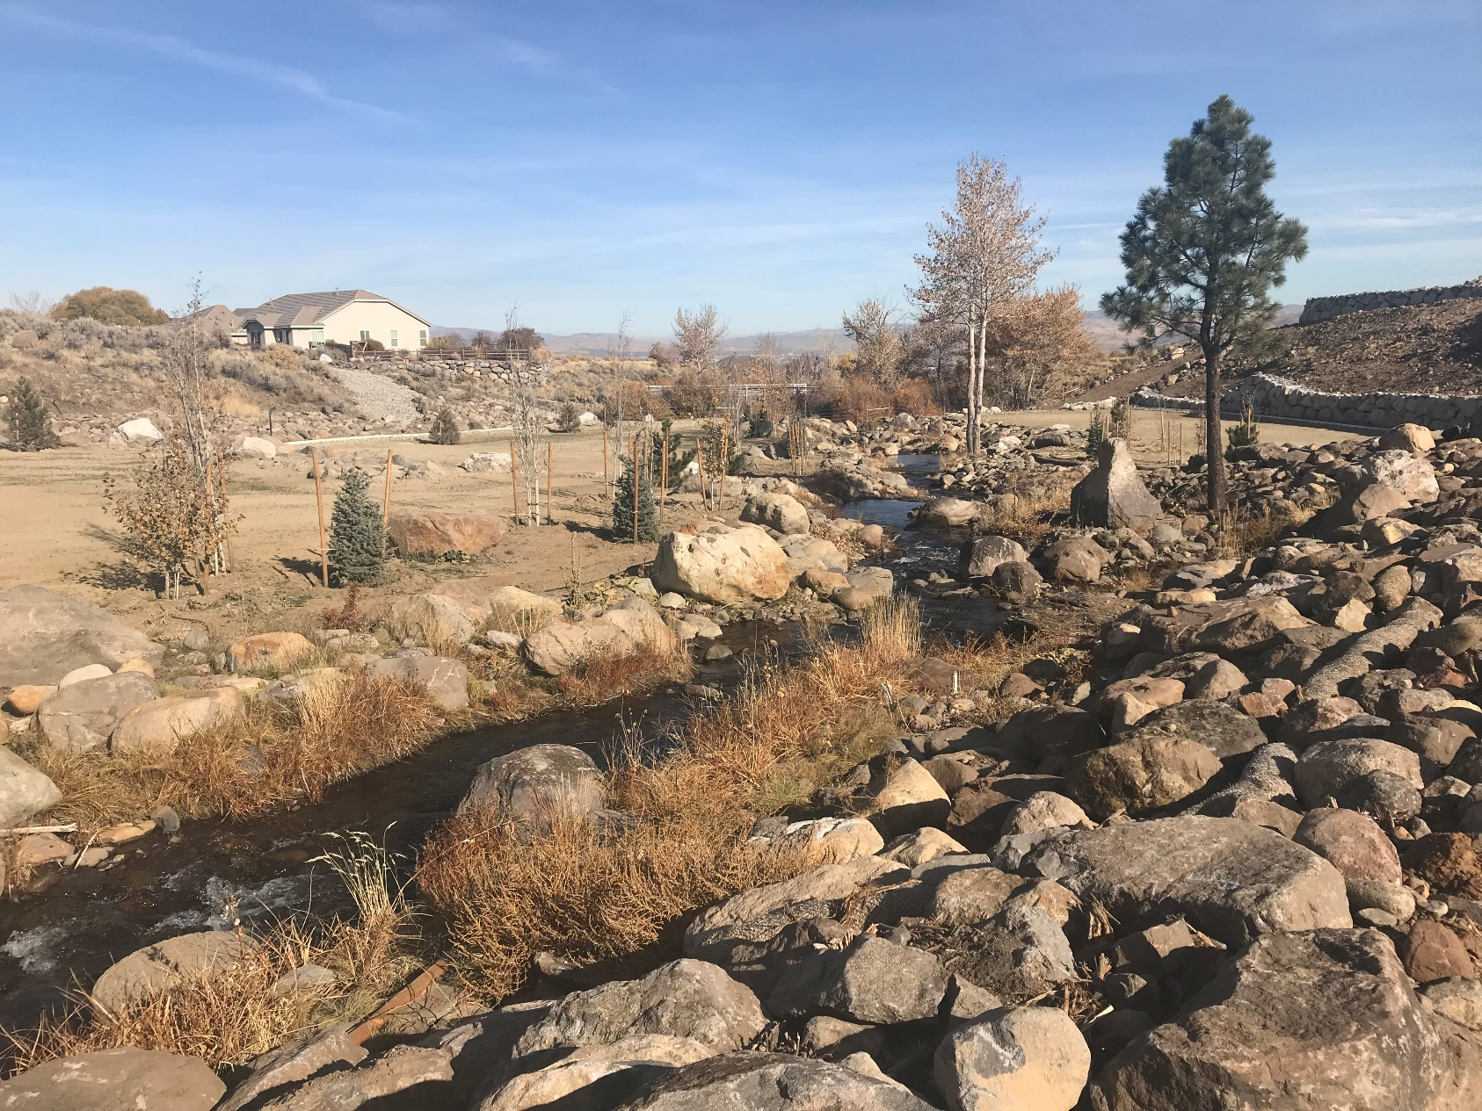
Photo of site on November 13, 2019

Slide 10
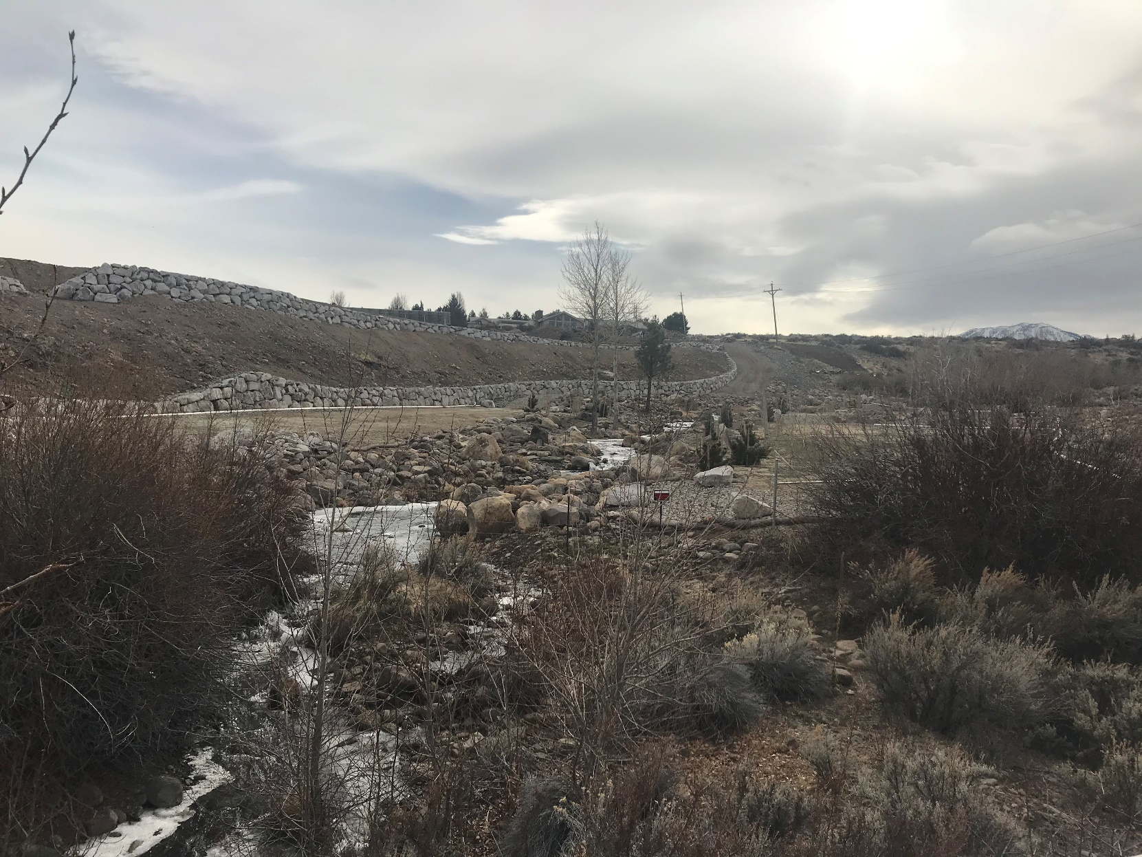
Photo of site on February 5, 2020

Slide 11
QUESTIONS

